Slide 1


PRESENTATION TITLE
CPSC 558
SPANNING TREE PROTOCOLS AND SHORTEST PATH BRIDGING
Chirag Padsala. CWID: 805613197
Palak Lodha. CWID: 805589165
Presented on: 05/01/2017

Slide 2
Problem Definition
STP errors are very common and during the past 15 years we have witnessed the same errors being made over-and-over again.
The most serious shortcoming is that STP has a brittle failure mode that can bring down entire data center or campus networks when something goes wrong.
Shortest path bridging is designed to address this problem by applying the Layer 3 routing protocol, but it is considered too complex as a protocol.

Slide 3
Outline
Spanning Tree Protocol
Rapid Spanning Tree Protocol
Multiple Spanning Tree Protocol
Live Project Demo
PVST and PVST+
Project Screenshots
Shortest Path Bridging

Slide 4
Project Flow
Plan: For this project we decided to study different cisco proprietary protocols and also the shortest path bridging.
How we did: We started learning about the protocols, the problems, the way it operates, the speed and accuracy and also compared them among each other to know the difference.
What we did: For understanding its actual operation, speed and accuracy, we decided to use cisco packet tracer, which helped us understand every minute details about the protocols.
In the first presentation we discussed about different types of protocols used now-a-days and in this presentation we will look into detail about each protocols.

Slide 5
Spanning Tree Protocol & Shortest Path Bridging
STP was created to prevent bridge loops by allowing only one path between network switches or ports.
STP was originally standardized as IEEE 802.1D.
Shortest path bridging is an evolution of the various spanning tree protocol, and is meant to replace the spanning tree protocol (STP).
On March 4th2006, 802.1aq draft was posted and on March 2012 IEEE approved 802.1aq standard.
SPB is fully backward compatible with all the various spanning tree protocols.

Slide 6
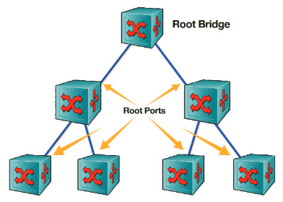
Spanning Tree Protocol
Dr. Radia Perlman invented STP in 1985 at the Digital Equipment Corporation and was known as IEEE 802.1D.
The Spanning Tree Protocol (STP) is a network protocol that ensures a loop-free topology for any bridged Ethernet local area network.
The basic function of STP is to prevent bridge loops and the broadcast radiation that results from them.
STP was designed to provide "plug-and-play“ operation for large Layer 2 networks based on shared Ethernet.
STP forces redundant data path into a blocked state.
Figure: STP Topology.

Slide 7
Bridges & Switches in STP
Bridge:
A bridge connects two or more LAN segments.
As of today’s switch based networks. For STP switch = bridge.
Root Bridge:
It’s the bridge(or switch) that provides connectivity for all segments.
Every bridge in a LAN has a path leading towards root bridge.
Root bridge is elected automatically based on elections and it can be elected/changed by the administrator.
Non-Root Bridge:
A bridge which is not the Root Bridge is considered Non-root Bridge.

Slide 8
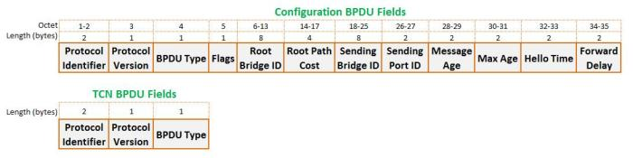
BPDU & Terminology in STP
Protocol ID: Contains the value 0000 for IEEE 802.1D
Version ID: Contains the value zero.
Flags: The Topology Change (TC) bit signals a topology change. The Topology Change Acknowledgment (TCA) bit is set to acknowledge receipt of a configuration message.
Root Bridge ID: Identifies the root bridge by listing its 2-byte priority number followed by its 6-byte MAC address.
Root Path Cost: Contains the cost of the path from the bridge to the Root Bridge.
Sender Bridge ID: Identifies the Sender bridge by listing its 2-byte priority number followed by its 6-byte MAC address.
Port ID: Identifies the port from which the configuration message was sent.
Message Age: The amount of time elapsed since the BPDU sent by Root Bridge(10 sec).
Maximum Age: Indicates when the current configuration message should be deleted (20 sec).
Hello time: Provides the time period between Root Bridge configuration messages.
Forward Delay: Provides the length of time that bridges should wait before transitioning to a new state after a topology change (15 sec).

Slide 9
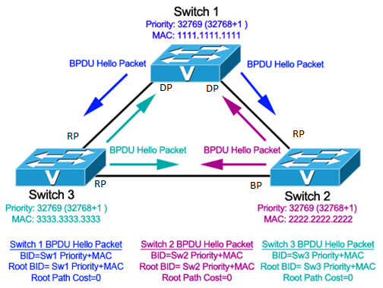
Operation of STP
Elect a “Root Bridge”
All non-root switches, selects a single “root port”
Block all redundant path except designated path.
Figure: STP Election.
STP Port Types:
DP: Designated Port
RP: Root Port
BP: Blocked Port

Slide 10
STP Port State & Roles
Port State
Disabled | No Mac Learning, No Forward Traffic and Does not receive BPDU
Blocking | No Mac Learning, No Forward Traffic and Receives BPDU
Listening | No Mac Learning, No Forward Traffic and Receives BPDU
Learning | Mac Learning, No Forward Traffic and Receives BPDU
Forwarding | Mac Learning, Forward Traffic and Receives BPDU
Port Roles
Root Port | Port to the root bridge
Designated Port | Port to lower segments
Non-Designated Port | Port that blocks traffic
Disabled Port | Non Participating

Slide 11
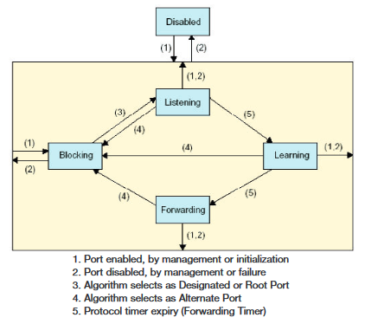
States of STP Ports
Blocking
Listening
Learning
Forwarding
Disabled
Figure: State Diagram of STP.

Slide 12
Rapid STP
RSTP provides significantly faster spanning tree convergence during creation and even after a topology change, introducing new convergence behaviors and bridge port roles to do this.
IEEE introduced Rapid Spanning Tree Protocol (RSTP) as 802.1w in 2011.
RSTP is backward compatible; it is designed to be compatible and interoperable with the legacy STP.

Slide 13
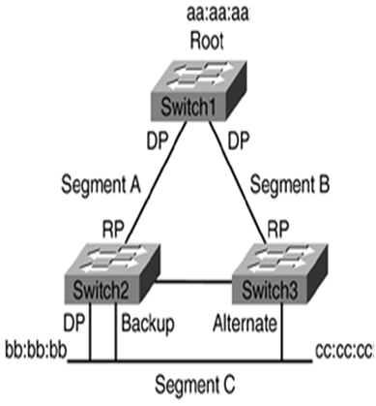
Operation of RSTP
RSTP operation is similar to STP but its faster because:
RSTP only has to wait 3*Hello (default 6 seconds).
It eliminates the forward delay (default 15 seconds) time in Listening States.
It eliminates the forward delay (default 15 seconds) time in Learning States.
Figure: RSTP

Slide 14
RSTP Port State & Roles
Port State
Forwarding | Mac Learning Forward Traffic
Learning | Mac Learning No Forward Traffic
Disabled | No Mac Learning No Forward Traffic
Port Roles
Root Port | Port to the root bridge
Designated Port | Port to lower segments
Alternate Port | Backup root port
Backup Port | Backup designated port
Disabled Port | Non participating.

Slide 15
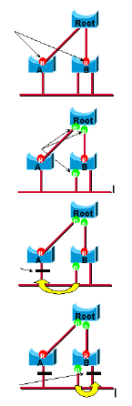
RSTP Ports
Root Port
Designated Port
Backup Port
Alternate Port
Port Speed & Cost
Port Speed | Port Cost
10 Mbps | 100
100 Mbps | 19
1 Gbps | 4
10 Gbps | 2

Slide 16
STP vs RSTP
Port State
STP port state | RSTP port state | Part of active topology | Learning of MAC addresses
Disabled | Discard | No | No
Blocking
Listening
Learning | Learning | No | Yes
Forwarding | Forwarding | Yes | Yes

Slide 17
STP vs RSTP
BPDU
 | STP | RSTP
BPDU handling | Non-root bridge only transmit BPDUs when it receives one on the root port. | Bridge sends BPDU at hello time intervals.
Aging | BPDU is aged after the max-age timer expires (and no BPDU is received on the port). | BPDUs are used like keepalive messages (after 3 BPDUs in a row are missed it ages it out).
Accepting inferior BPDUs | __ | Inferior BPDU accepted and previously stored information is replaced.
Transition to forwarding state | Based on timers (Forward Delay and Max-Age). | Uses a feedback mechanism (Edge ports & link type).

Slide 18
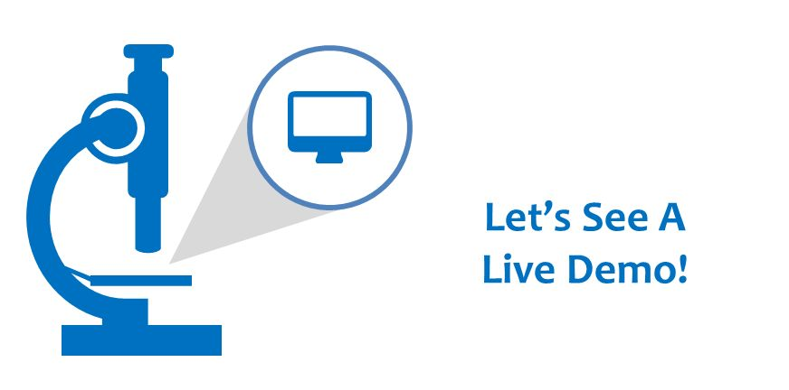

Slide 19
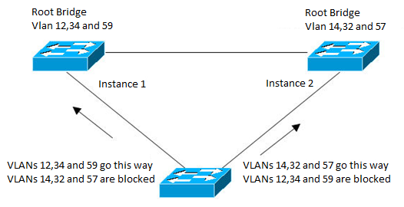
MSTP
MSTP, originally defined in 802.1Q-2005, allows mapping multiple VLANs to a single spanning tree instance.
This reduces the resource requirement while preserving the advantages of having multiple spanning trees for load balancing purposes.
In the example below, the VLANs are mapped to 2 separate spanning tree instances as follows:
VLANs 12,34 and 59 : Spanning tree instance 1
VLANs 14,32 and 57 : Spanning tree instance 2

Slide 20
MSTP
Configuration of MSTP:
Sw1(config)# spanning-tree instance configuration
Sw1(config-mst)# instance 1 vlan 12,34,59
Sw1(config-mst)# instance 2 vlan 14,32,57
Sw1(config-mst)# spanning-tree mst 1 root primary
Sw1(config-mst)# spanning-tree mst 2 root secondary
Sw1(config-mst)# spanning tree mode mst
Similarly we configure Sw2 (Switch 2) with mst 1 as secondary and mst 2 as primary.

Slide 21
MSTP Port Type
Backup Port
A message is received from the bridge itself
Root Port
A message is received with a better root
A message is received with the same root
Designated Port
Initialization
A message with a better path cost to root
A message with the same path cost to root
Alternate Port
The port it not backup, not root port and not designated
The port is a Master Port – in the MSTIs
The port is connected to a LAN or a bridge in a different region

Slide 22
PVST
Per-VLAN Spanning Tree (PVST) maintains a spanning tree instance for each VLAN configured in the network. It uses ISL Trunking and allows a VLAN trunk to be forwarding for some VLANs while blocking for other VLANs.
Since PVST treats each VLAN as a separate network, it has the ability to load balance traffic (at layer-2) by forwarding some VLANs on one trunk and other VLANs on another trunk without causing a Spanning Tree loop.

Slide 23
PVST+
PVST+ is a Cisco proprietary extension to 801.2d STP that provides a separate 802.1 spanning-tree instance for each VLAN configured on your switches.
All of Cisco proprietary extensions were created to improve convergence times, which is 50 seconds by default, which means you will have optimal path selection, but the convergence time will still be slow.
Creating a per-VLAN STP instance for each VLAN is worth the increased CPU and memory requirements, because it allows for per-VLAN root bridges.
This feature allows the STP tree to be optimized for the traffic of each VLAN by allowing you to configure each root bridge in the center of each of them.

Slide 24
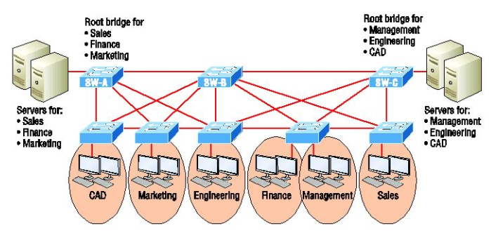
Difference between PVST+ and STP
This root bridge placement clearly enables faster convergence as well as optimal path determination.
The difference is that, common spanning tree has one instance of STP no matter how many VLANs you configured on your network and with PVST+ , convergence happens on a per VLAN basis, with each VLAN running its own instance of STP.

Slide 25
Project Screenshots

Slide 26
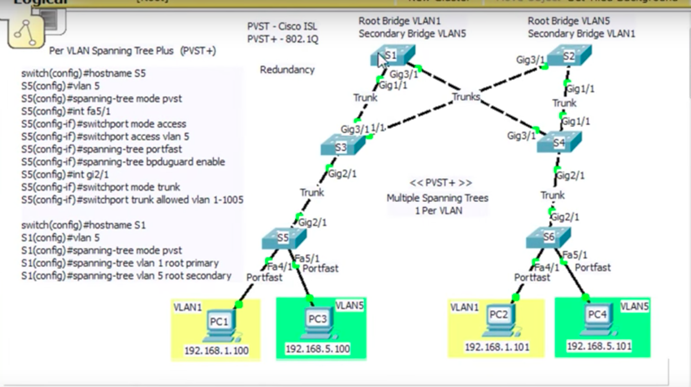

Slide 27
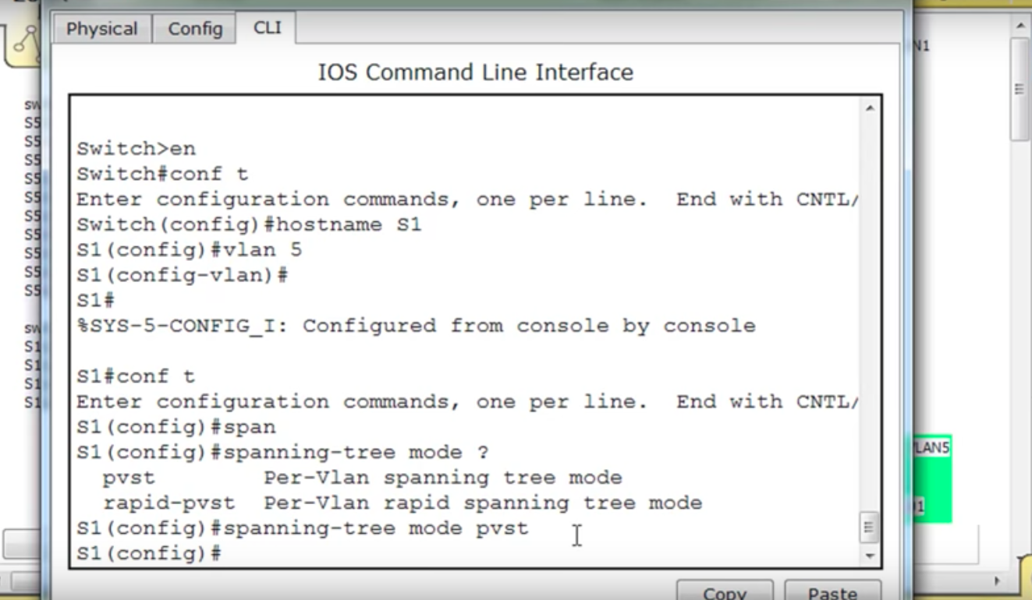

Slide 28
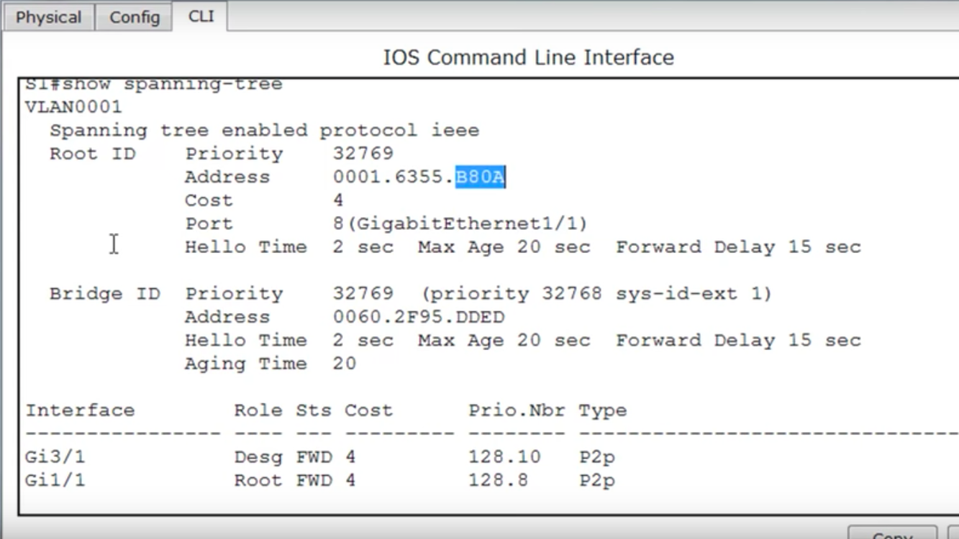

Slide 29
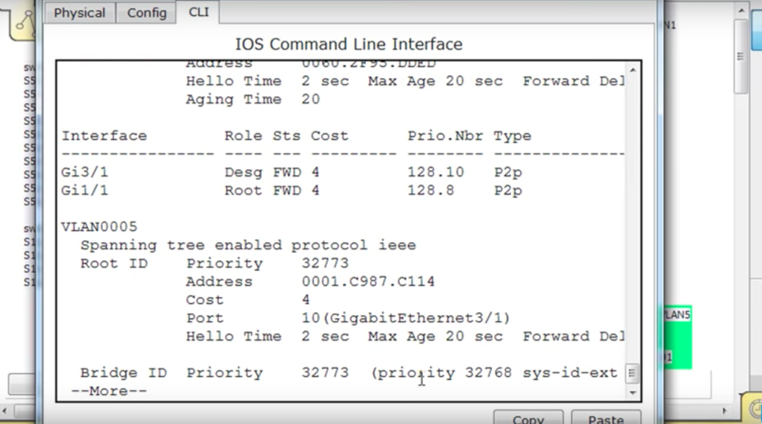

Slide 30
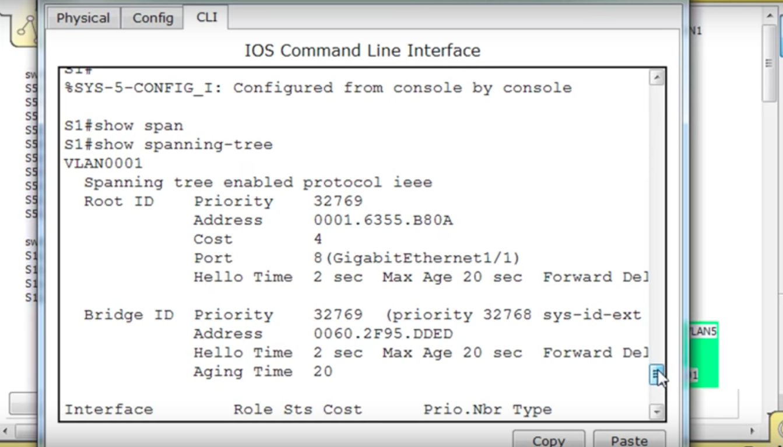

Slide 31
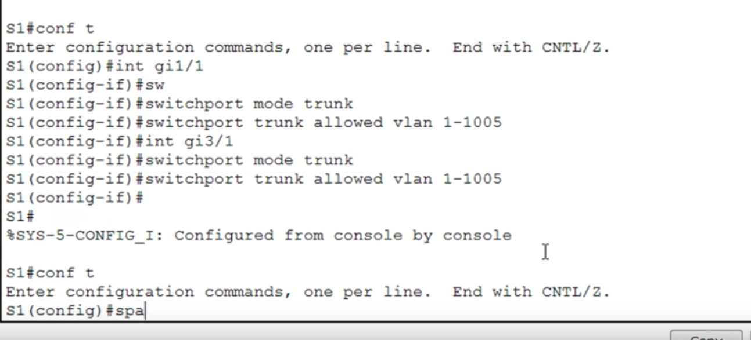

Slide 32
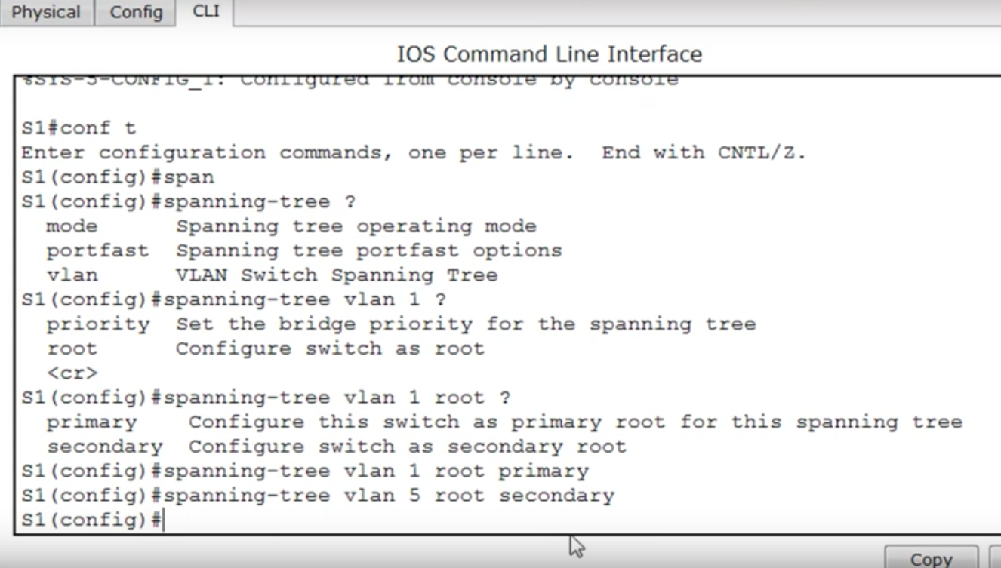

Slide 33
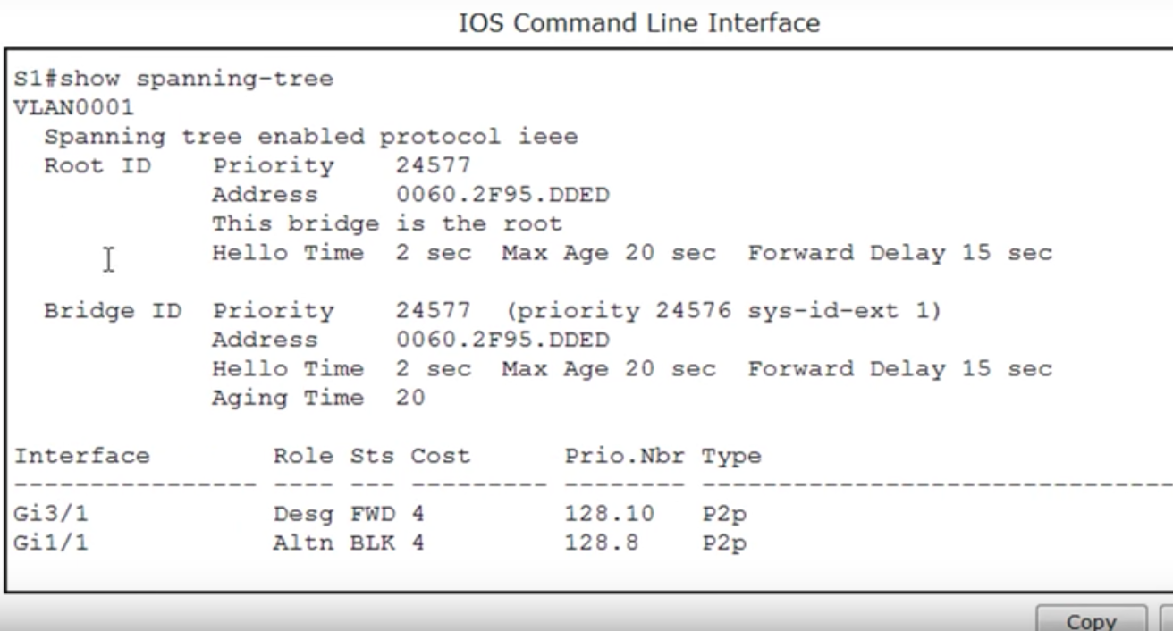

Slide 34
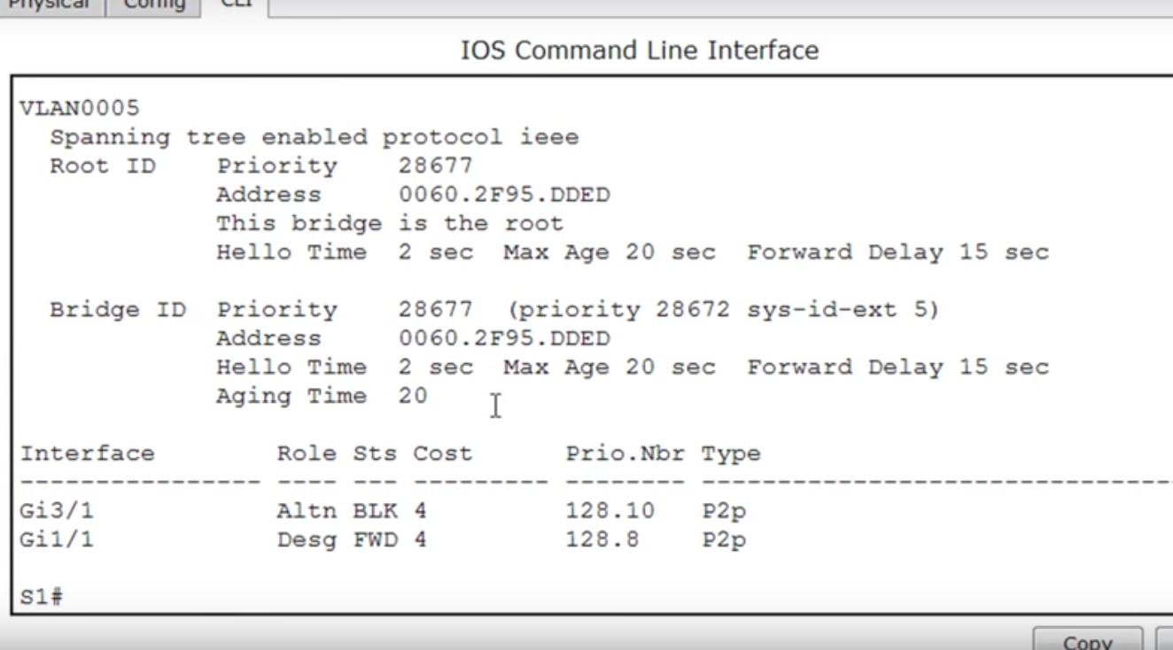

Slide 35
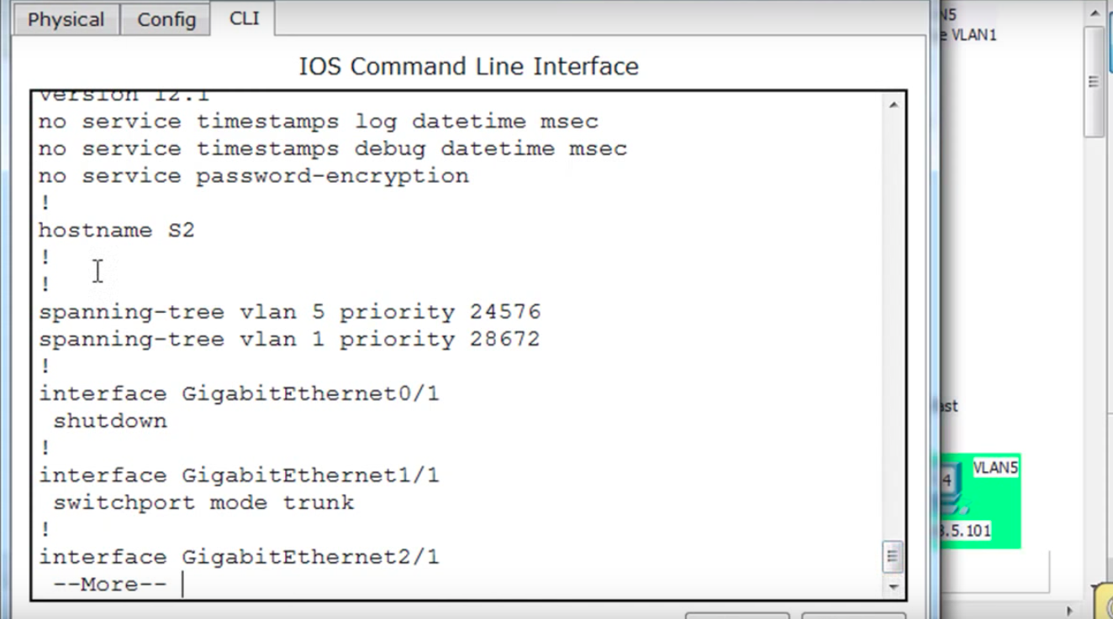

Slide 36
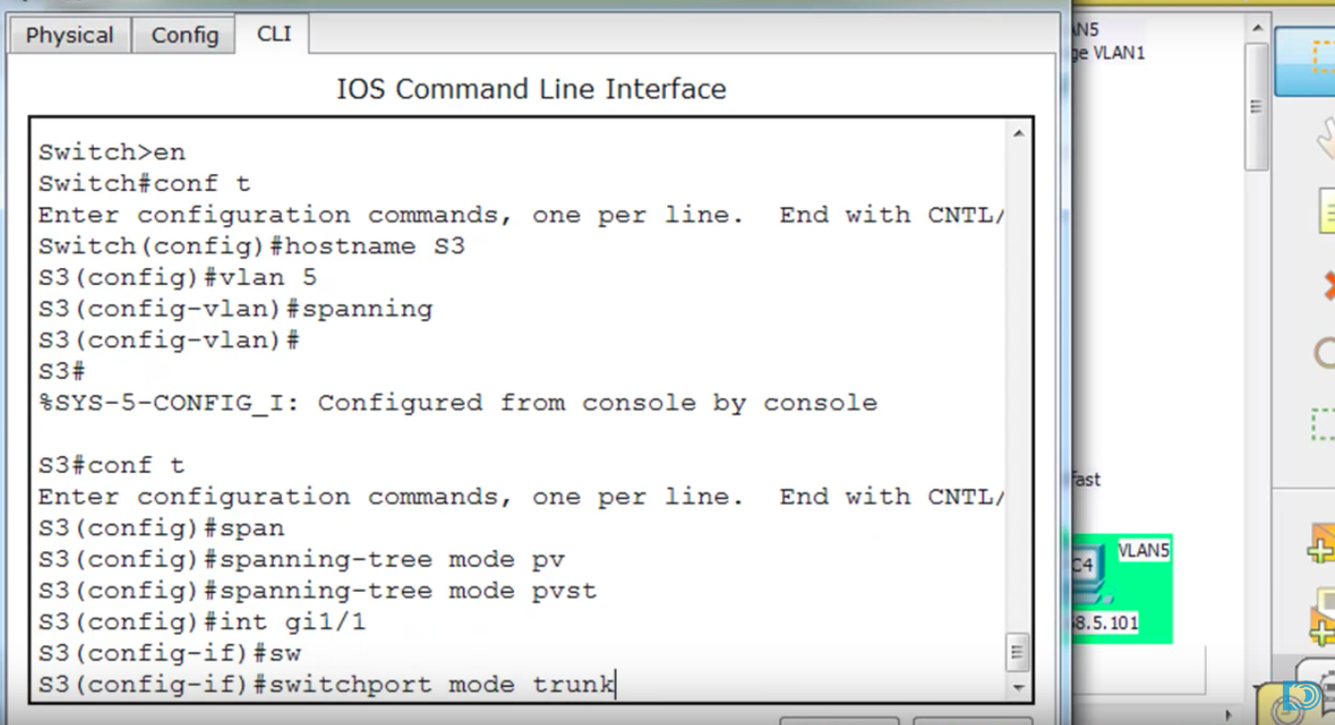

Slide 37
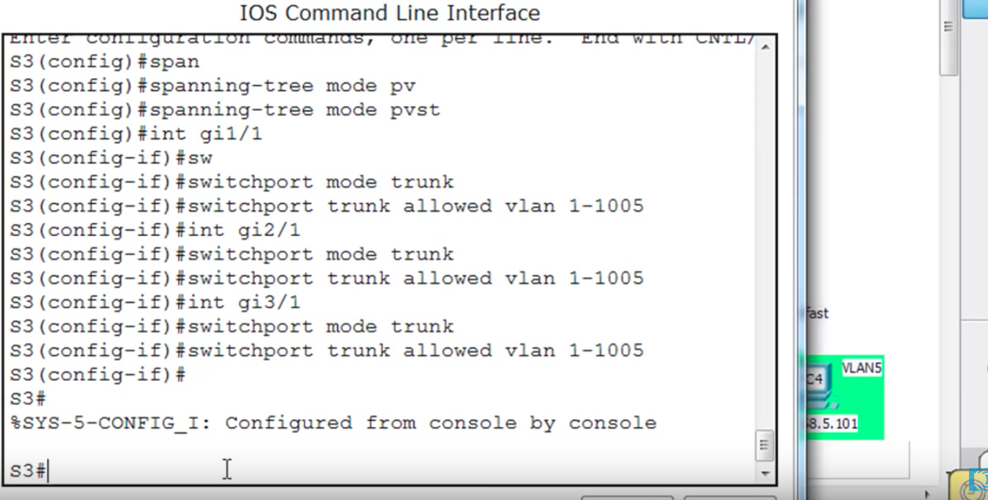

Slide 38
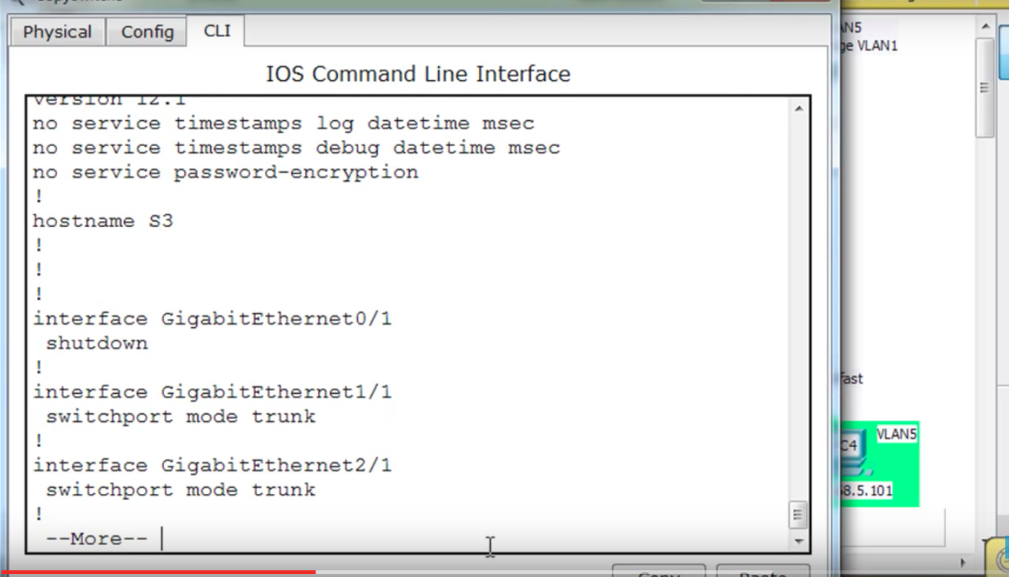

Slide 39
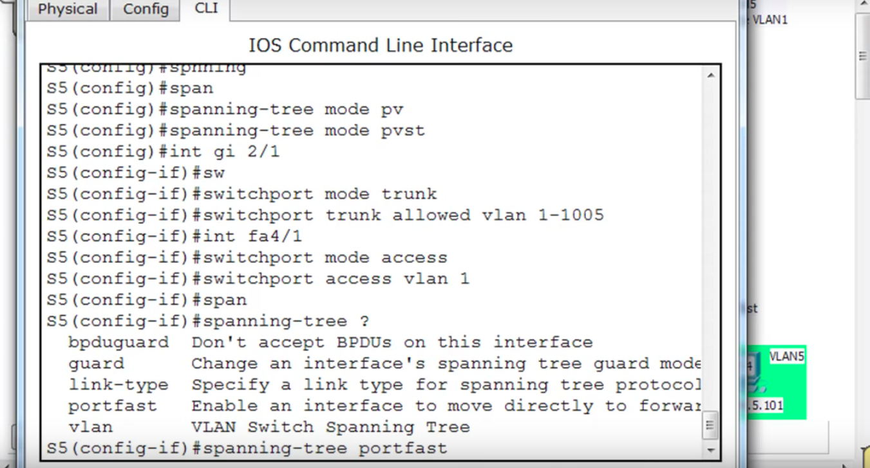

Slide 40
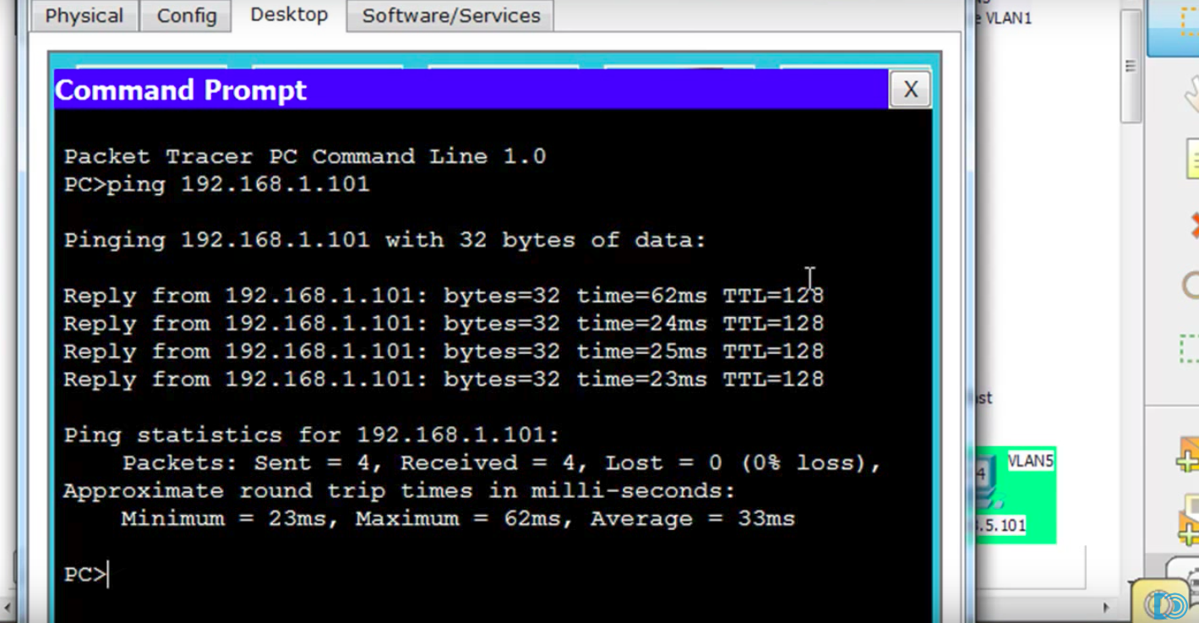

Slide 41
Shortest Path Bridging
Shortest Path Bridging is a computer networking technology intended to simplify the creation and configuration of networks, while enabling multipath routing.
The technology provides logical Ethernet networks on native Ethernet infrastructures using a link state protocol to advertise both topology and logical network membership. Packets are encapsulated at the edge either in media access control-in-media access control 802.1ah or tagged 802.1Q/802.1ad frames and transported only to other members of the logical network.

Slide 42
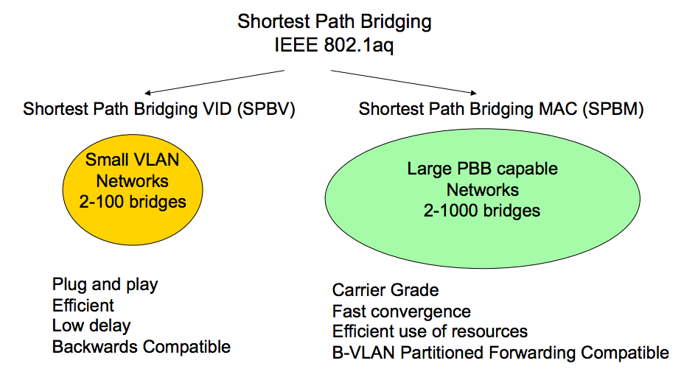
Operating Modes

Slide 43
SPBV
A primary feature of Shortest Path bridging is the ability to use Link State IS-IS to learn network topology. In SPBV the mechanism used to identify the tree is to use a different Shortest Path VLAN ID (VID) for each source bridge. The IS-IS topology is leveraged both to allocate unique SPVIDs and to enable shortest path forwarding for individual and group addresses.
SPB defines a shortest path Region which is the boundary of the shortest path topology and the rest of the VLAN topology. SPB operates by learning the SPB capable bridges and growing the Region to include the SPB capable bridges that have the same Base VID and MSTID configuration digest
SPBV builds shortest path trees that support Loop Prevention and optionally support loop mitigation on the SPVID. SPBV still allows learning of Ethernet MAC addresses but it can distribute multicast address that can be used to prune the shortest path trees according to the multicast membership either through Multiple MAC Registration Protocol (MMRP) or directly using IS-IS distribution of multicast membership.

Slide 44
SPBM
In SPBM, the Backbone MAC (B-MAC) addresses of the participating nodes and also the service membership information for interfaces to non-participating devices (user network interface (UNI) ports) is distributed. Topology data is then input to a calculation engine which computes symmetric shortest path trees based on minimum cost from each participating node to all other participating nodes.
In SPBM the shortest path trees are then used to populate forwarding tables for each participating node's individual B-MAC addresses and for Group addresses; Group multicast trees are sub trees of the default shortest path tree formed by (Source, Group) pairing.
Depending on the topology several different equal cost multi path trees are possible and SPB supports multiple algorithms per IS-IS instance.

Slide 45
The Difference
SPBV provides capability that is backwards compatible with spanning tree technologies. SPBM provides additional values which capitalize on Provider Backbone Bridge (PBB) capabilities.
SPB combines an Ethernet data path (either IEEE 802.1Q in the case of SPBV, or Provider Backbone Bridges (PBBs) IEEE 802.1ah in the case of SPBM) with an IS-IS link state control protocol running between Shortest Path bridges (network-to-network interface (NNI) links).
One (SPBM) is intended where complete isolation of many separate instances of client LANs and their associated device MAC addresses is desired, and it therefore uses a full encapsulation (MAC-in-MAC a.k.a. IEEE 802.1ah). The other (SPBV) is intended where such isolation of client device MAC addresses is not necessary, and it reuses only the existing VLAN tag a.k.a. IEEE 802.1Q on participating network-to-network interface (NNI) links.

Slide 46
Benefits
The ability to use all available physical connectivity, because loop avoidance uses a Control Plane with a global view of network topology.
Fast restoration of connectivity after failure, again because of Link State routing's global view of network topology.
Under failure, the property that only directly affected traffic is impacted during restoration; all unaffected traffic just continues.
Rapid restoration of broadcast and multicast connectivity, because IS-IS floods all of the required information in the SPB extensions to IS-IS, thereby allowing unicast and multicast connectivity to be installed in parallel, with no need for a second phase signaling process to run over the converged unicast topology to compute and install multicast trees.

Slide 47
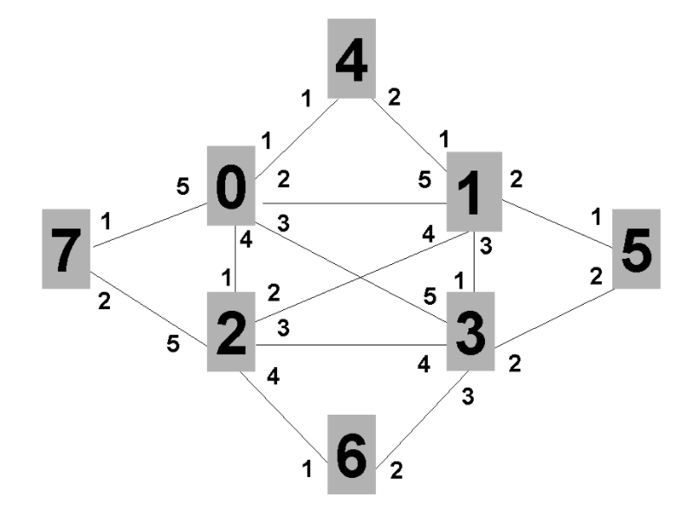
Example

Slide 48
Applications
In May 2013, the first public multi-vendor interoperability was demonstrated as SPB served as the backbone for Interop 2013 in Las Vegas.
The 2014 Winter Olympics were the first "fabric-enabled" Games using Shortest Path Bridging (SPB) "IEEE 802.1aq" technology. During the games this fabric network was capable of handling up to 54,000 Gbit/s (54 Tbit/s) of traffic. In 2013 and 2014 SPB was used to build the Interop Net backbone with only 1/10 the resources of prior years. During Interop 2014 SPB was used as the backbone protocol which can enable Software-defined networking (SDN) functionalities.

Slide 49
Summary
SPB is the replacement for the older spanning tree protocols: IEEE 802.1D, IEEE 802.1w, IEEE 802.1s.
These blocked any redundant paths that could result in a layer 2 loop, whereas SPB allows all paths to be active with multiple equal cost paths, provides much larger layer 2 topologies, supports faster convergence times, and improves the efficiency by allowing traffic to load share across all paths of a mesh network.

Slide 50
References
http://www.force10networks.com/whitepapers/pdf/F10_wp19_v1%201.pdf
https://en.wikipedia.org/wiki/IEEE_802.1aq
https://www.internet2.edu/presentations/jt2010july/20100712-Shortest_Path_Bridgingv3-Fedyk.pdf
http://www.cisco.com/c/en/us/td/docs/switches/datacenter/nexus5000/sw/configuration/guide/cli/CLIConfigurationGuide/RPVSpanningTree.html
https://www.youtube.com/watch?v=t15CsE-6Chg
http://www.brocade.com/content/html/en/configuration-guide/FI_08030_L2/GUID-F9905D20-F2BB-4286-B606-49BC36596CF1.html

Slide 51


